Slide 1
INT Latency Test
April.2020

Slide 2
Outline
Latency Measurement Introduction
  Macro Function Introduction
  Environment Setting
Appendix
  Test Flow

Slide 3
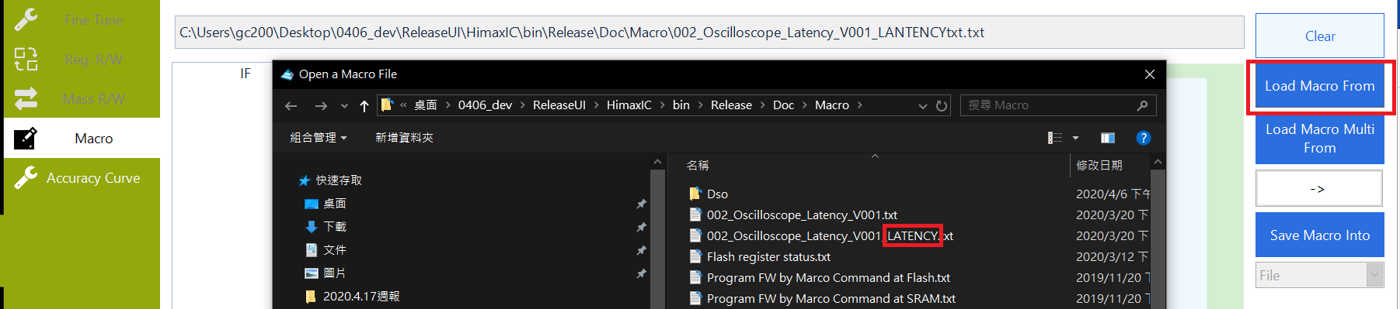
Latency Measure Introduction
Introduction
  Use Macro to test report point latency
Test Step
  Load Latency Macro file
  Setup Oscilloscope’s CH1 and CH2 to correspond pin you wants.
  Before you start test , you must check you device is in sensing status.

Slide 4



Circuit Diagram
CH2→INT
Panel
Oscilloscope
Bridge
Relay2
Relay1
CH1→Relay

Slide 5
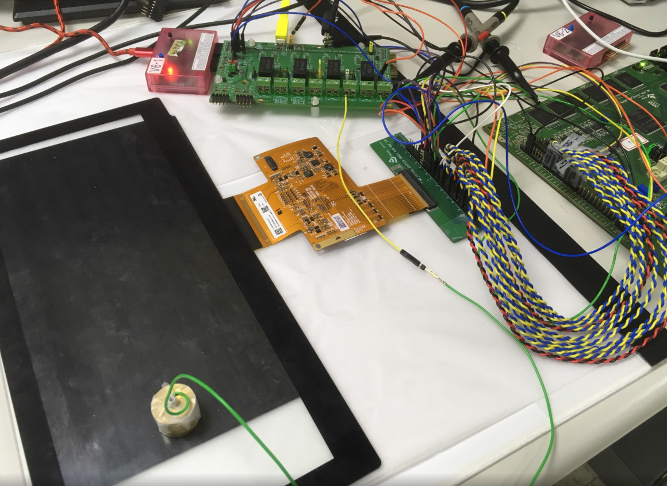
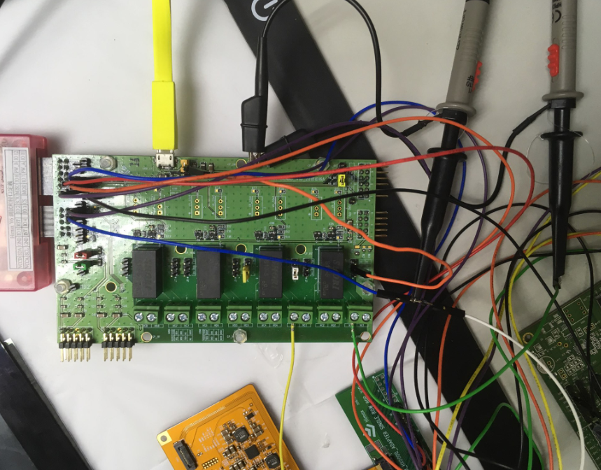
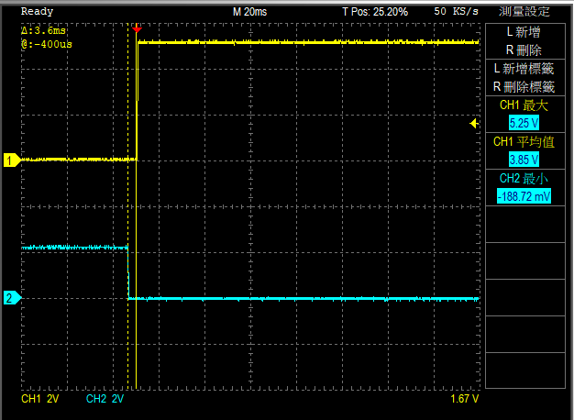
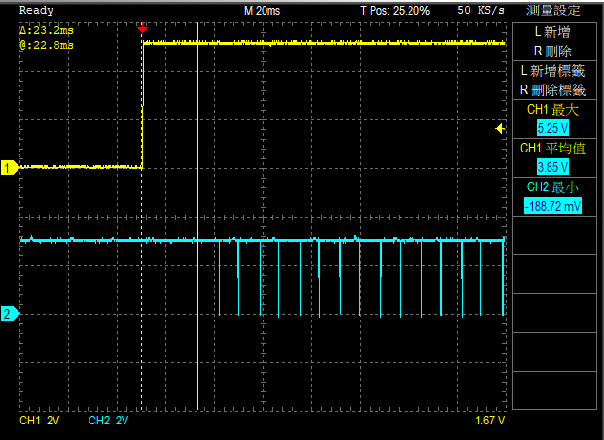
Measure Method
CH2 → TSIX
CH1 → relay
relay
Cu rod
Relay
Relay
Reaction time
GPIO
TSIX

Slide 6
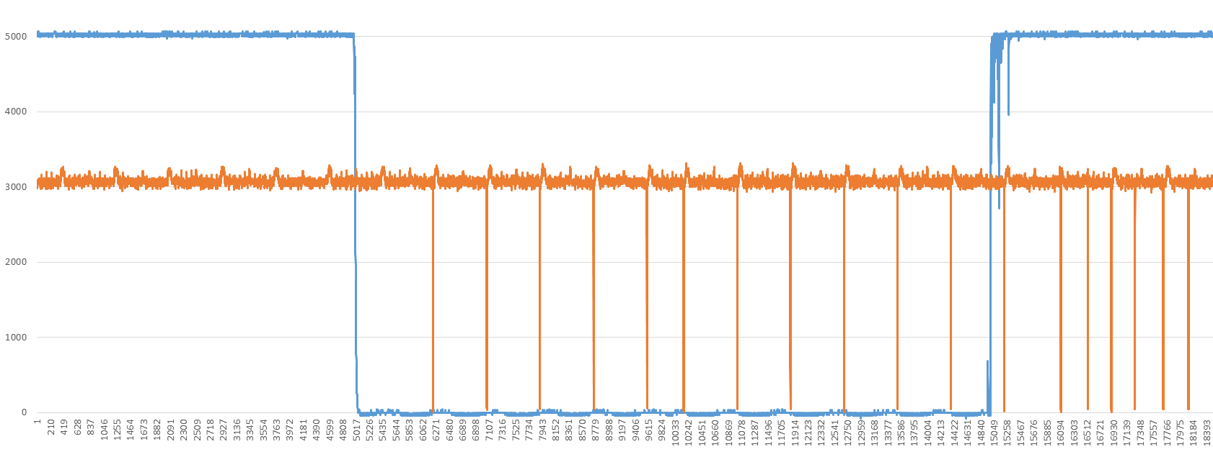
Experiment
Example
  We want to measue Latency time between Relay and Int as follow.
Relay
Int
Latency

Slide 7
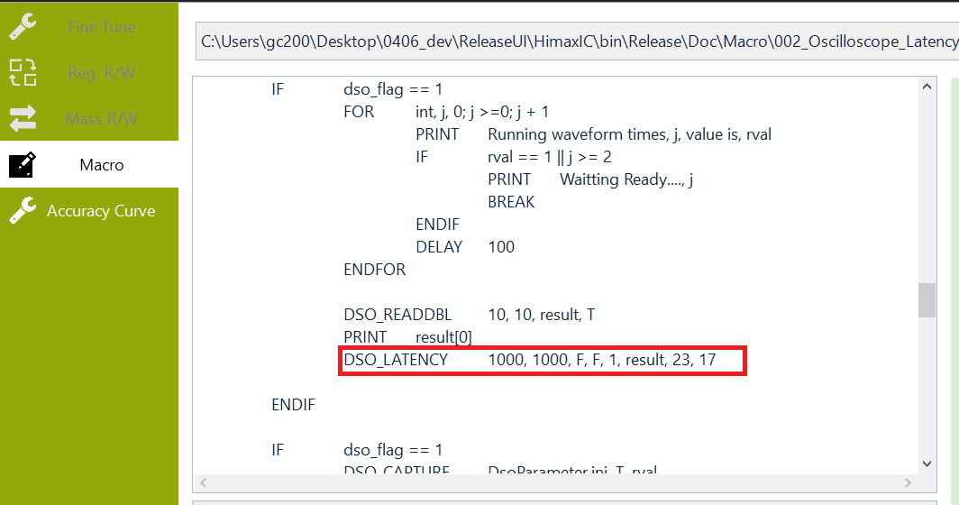
Experiment
DSO_LATENCY function have 8 parameters to set.

Slide 8
Setting Example
DSO_LATENCY function have 8 parameter to set
  CH1 Threshold
  CH2 Threshold
  CH1 isRising
  CH2 isRising
  CH1&2 Continue Count
  Data Out print in Macro
  Upper value (dump data threshold)
  Lower value (dump data threshold)
Macro Example
1~8

Slide 9
Setting Example
DSO_LATENCY
  CH1 Threshold
  CH2 Threshold
  CH1 isRising
  CH2 isRising
1
3
CH1
CH2
CH1 isRising = false
CH1 Threshold = 1000
Measure Start

Slide 10
Setting Example
DSO_LATENCY
  CH1 Threshold
  CH2 Threshold
  CH1 isRising
  CH2 isRising
2
4
CH1
CH2
CH2 isRising = false
CH2 Threshold = 1000
Measure End

Slide 11
Setting Example
DSO_LATENCY
  CH1&2 Continue Count
5
Continue Count=1
(Falling count)
Latency

Slide 12
Setting Example
DSO_LATENCY
  Data Out print in Macro
result
  result[0]=Latency time
  result[1]=Max latency time
  result[2]=Min latency time
  result[3]=Average latency time

Slide 13
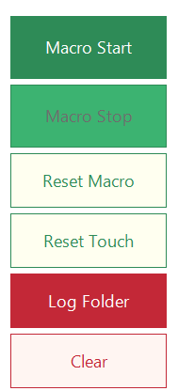
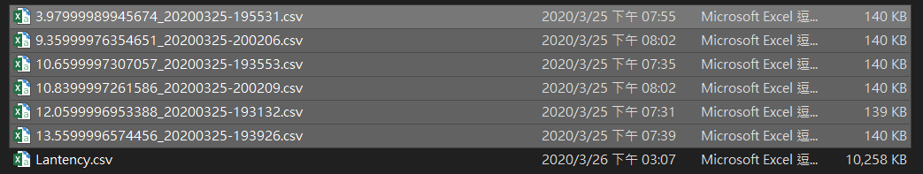
Setting Example
DSO_LATENCY
  Upper value (Dump log data if latency large than 23ms)
  Lower value (Dump log data if latency smaller than 17ms)
ms

Slide 14
Outline
Latency Measurement Introduction
  Macro Function Introduction
  Environment Setting
Appendix
  Test Flow

Slide 15
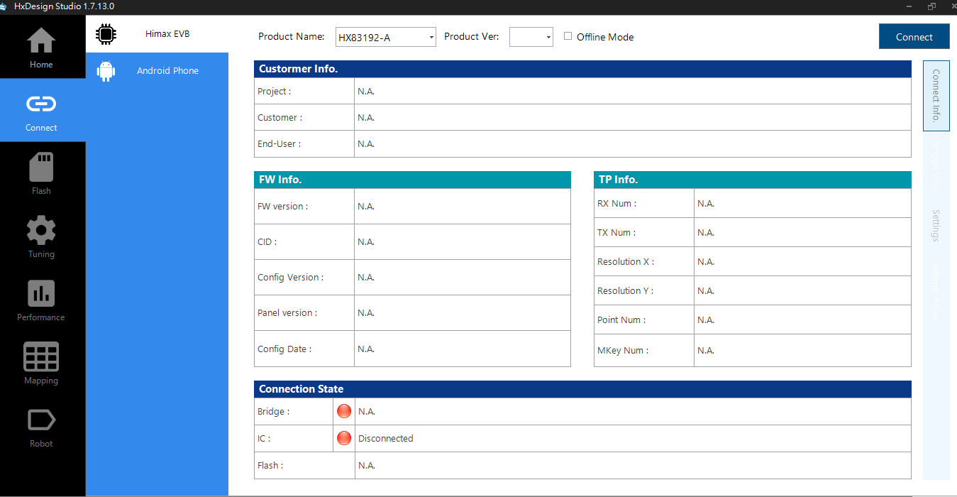
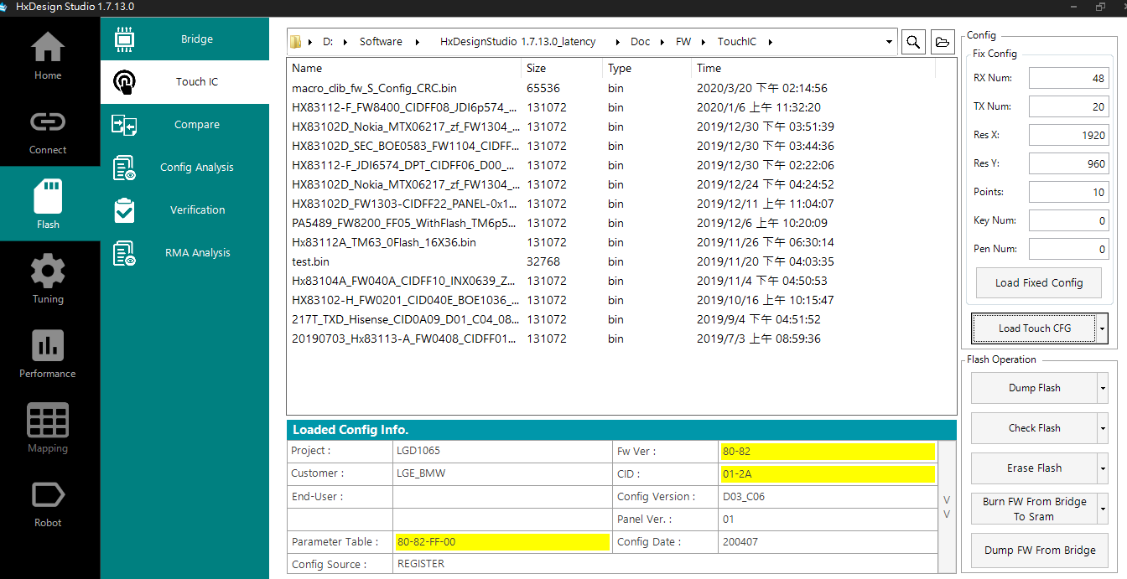
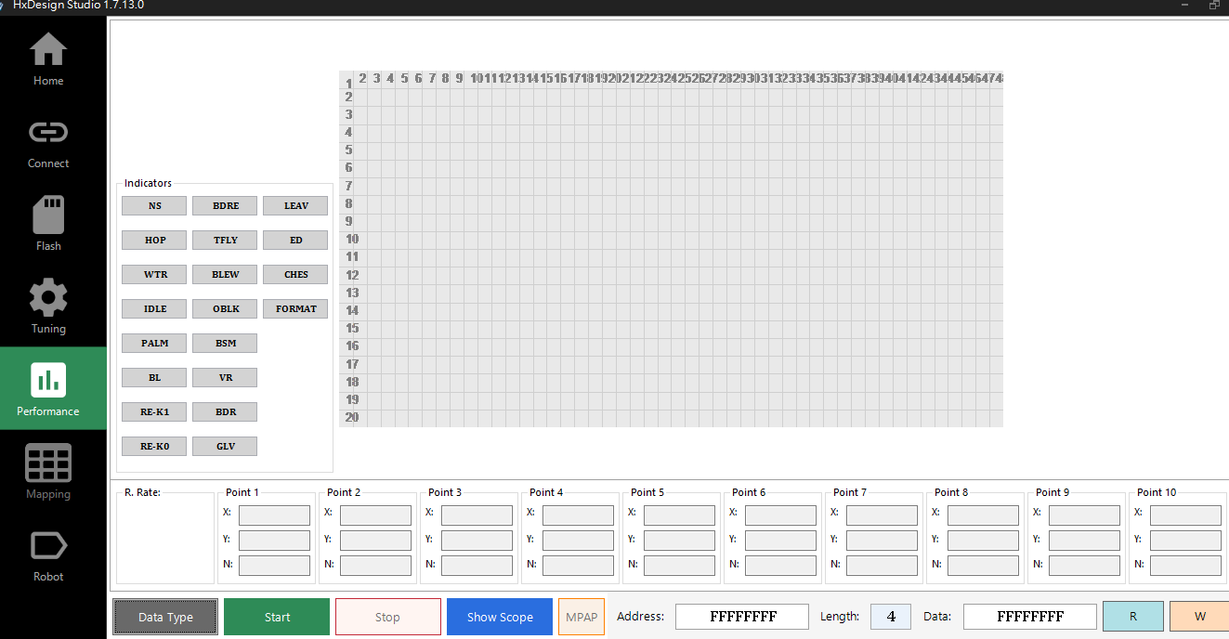
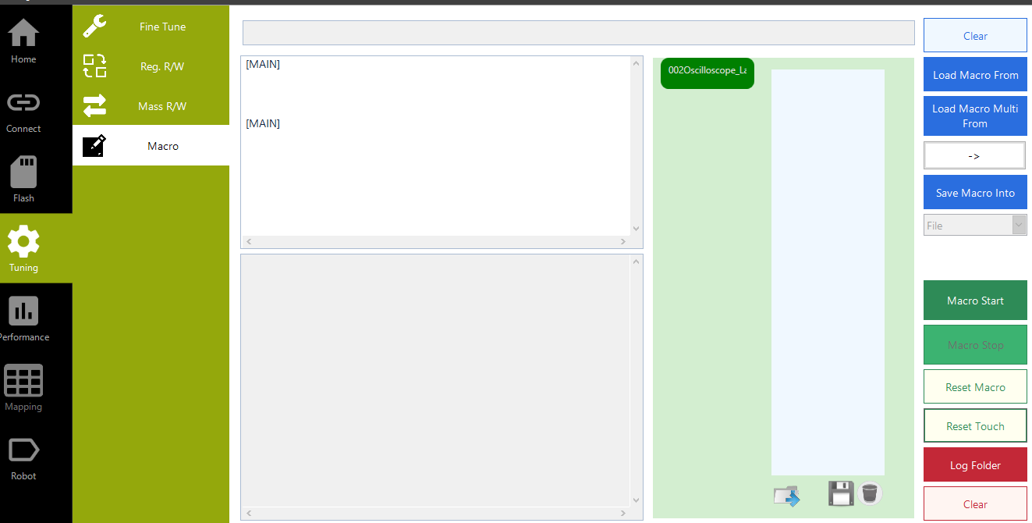
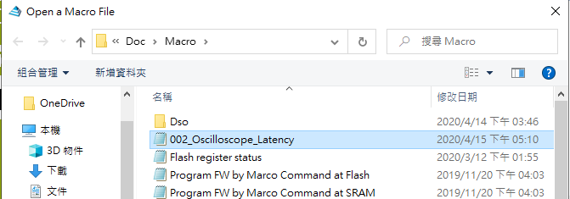
Test Step
1
2
4
6
3
5

Slide 16
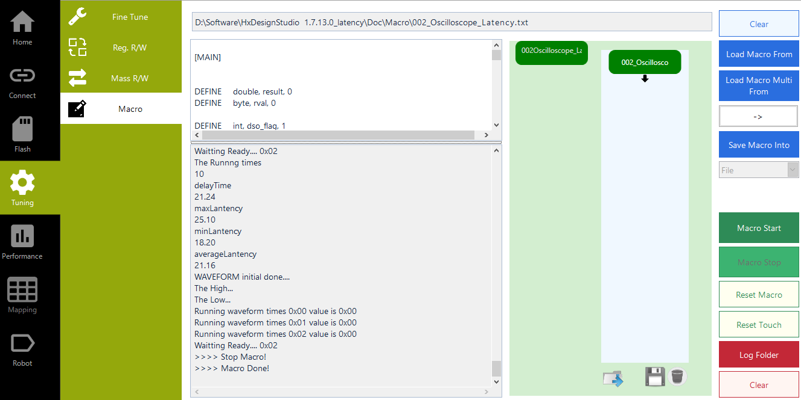
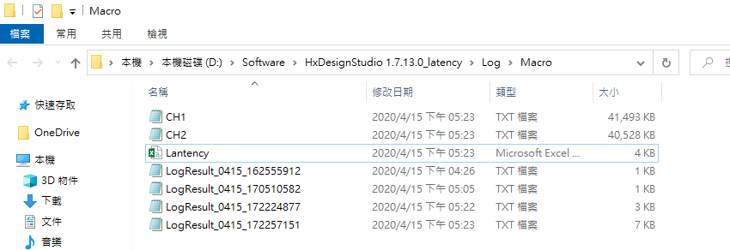
Test Step
Data
7
8
List

Slide 17

Drive for better vision

